Slide 1

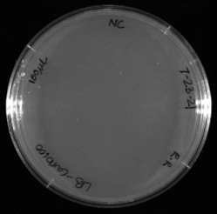
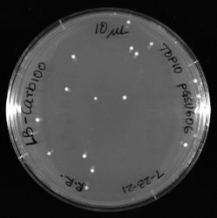
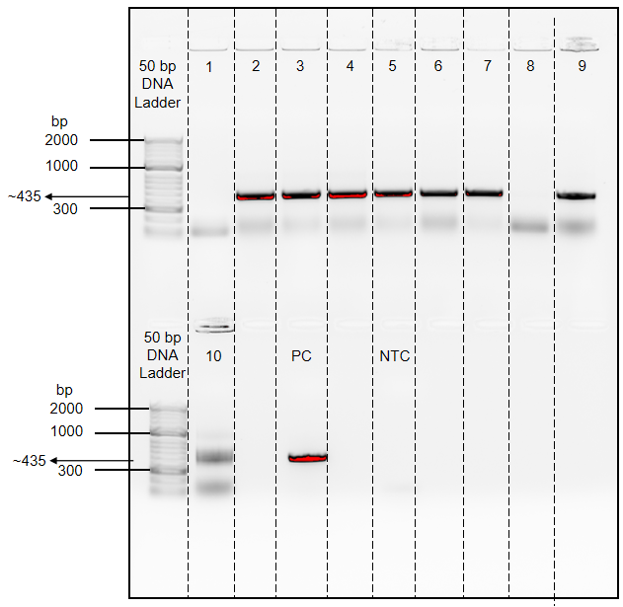
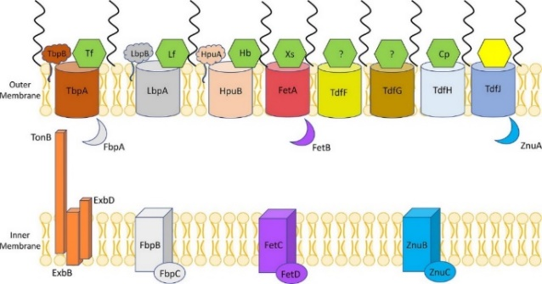
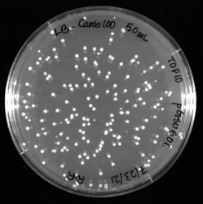
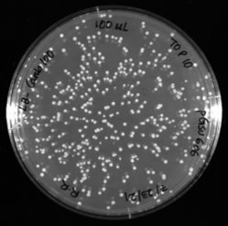
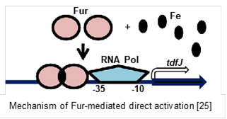
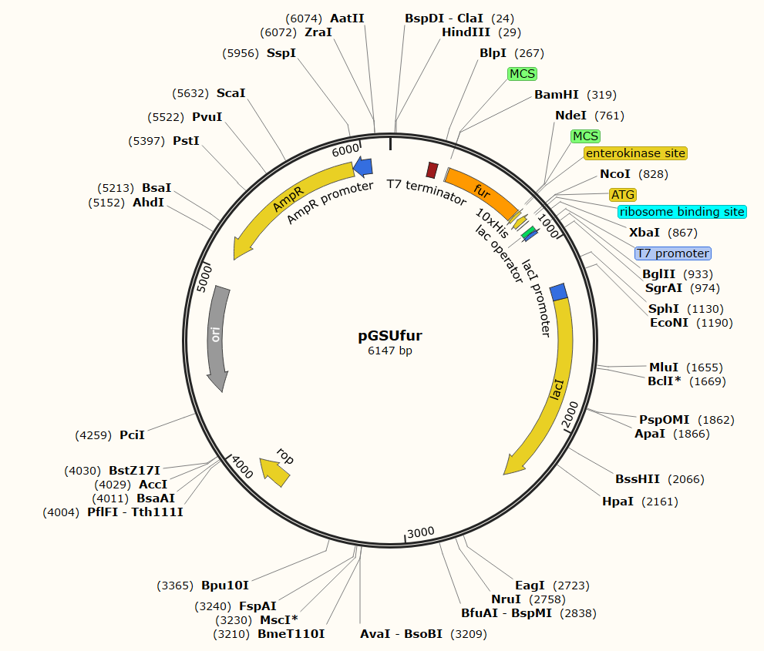
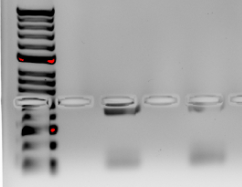
G E O R G I A S T A T E U N I V E R S I T Y
Analysis of Fur-dependent gene regulation of the gonococcal TonB-dependent transport proteins involved in zinc acquisition
Ruwaida Raneem Rajna, Sandhya Padmanabhan, MS, Julie Lynn Stoudenmire-Saylor, PhD, Cynthia N. Cornelissen, PhD, Institute for Biomedical Sciences, Georgia State University
INTRODUCTION
METHODS AND RESULTS
Adapted from: Maurakis, S., Cornelissen, C. N., et al (2019). PLoS pathogens, e1007937
Fig 1. Outer membrane of Neisseria gonorrhoeae constitutes of Ton-B dependent transport proteins (TdTs) which fight against the host body’s nutritional immunity. TdfJ binds S100A7 and imports essential zinc for the bacteria to survive
Neisseria gonorrhoeae (Ngo) is the causative agent of the sexually transmitted infection gonorrhea that affects men and women worldwide. Gonococcal infection can lead to serious sequelae including infertility in both men and women.
However, vaccine development has been challenging owing to the high frequency phase and
antigenic variation of the most common bacterial outer membrane vaccine targets.
Previous research tells us that TonB-dependent transport proteins (TdTs) are ideal vaccine candidates. TdTs on the outer membrane of the bacterium work against the body’s nutritional immunity to acquire essential metals. TdfJ is a TdT that fights against the host's S100A7 nutritional immunity.
Adapted from: Yu C, Genco CA: Fur-mediated global regulatory circuits in pathogenic Neisseria species. J Bacteriol 2012, 194(23):6372-6381
TdfJ acquires zinc within low zinc environments. tdfJ expression is induced in high iron and low zinc environments. Thus, it was hypothesized that the Ferric Uptake Regulator (Fur) acts as an activator for the induction of tdfJ in Ngo. Fur is thought to sit on the DNA upstream of the tdfJ promoter and allow the RNA polymerase to activate the expression of tdfJ.
The current study focuses on purification and expression of Fur to analyze this interaction. The study’s results will inform if Fur interacts with the tdfJ promoter region to induce expression and aid in zinc uptake by TdfJ.
STRAINS USED:
FA1090 N. gonorrhoeae, TOP 10/DH5α E. coli, BL21 E. coli
S100A7
Cloning and Transformation
Protein Purification and EMSA- Future directions
Make primers to amplify Ngo fur
Transform E. coli expression strain with pGSU606
-
Make plasmid map of vector + insert (pET19b+fur)
Induce Fur protein production by growing transformants + IPTG
Fig 5&6. Transformants on plates were screened by colony PCR using fur primers
PCR amplify and purify fur product (insert DNA)
Purify Fur using a Nickel column
Plasmid mini-prep and purify vector pET19b DNA
Label tdfJ promoter DNA fragment and perform EMSA
CONCLUSIONS
By mapping the fur gene within the MCS of pET-19b plasmid, we structured how the insert and vector will fit together inside the E coli cells. After purifying and amplifying the fur gene and by isolating our pET-19 vector DNA we were able to ligate them to generate pGSU606 (insert + vector). Then, we transformed TOP10 E. coli cells with pGSU606 and conducted PCR to see if the (insert + vector) number of base pairs fall within the range as according to the mapping. Now, we plan to send it for DNA sequencing to check if the sequence matches our mapped sequence. After sequencing, we will transform BL21 E. coli cells with pGSU606 to get our final transformants. These final transformants will be used to purify Fur proteins and to check for induction of tdfJ expression. This will help us better understand tdfJ how acquires necessary zinc and how Fur promotes for its activation.
Clone fur into pET19b (pGSU606)
Test binding of Fur to tdfJ promoter
Transform E.coli with pGSU606 and screen transformants by sequencing
Identify Fur-binding region on tdfJ promoter for iron-dependent regulation
Fig 2. Hypothesized mechanism of Fur-mediated direct activation of tdfJ
Fig 3. Plasmid map of fur (insert) in pET-19b plasmid (vector) to check if it is in frame within the Multiple Cloning Site (MCS)
FUTURE DIRECTIONS
If Fur does not act as an inducer, at the tdfJ locus, we use RNA sequencing to gather information on all the inducers that could possibly affect tdfJ expression.
2. If Fur does act as an inducer, then we propose to perform DNase 1 footprinting assay to find the Fur-box sequence on the tdfJ promoter.
50bp DNA Ladder
REFERENCES
fur
NTC
Maurakis S, Keller K, Maxwell CN, Pereira K, Chazin WJ, Criss AK, & Cornelissen CN: The novel interaction between Neisseria gonorrhoeae TdfJ and human S100A7 allows gonococci to subvert host zinc restriction. PLoS pathogens 2019, 15(8), e1007937.
Yu C, Genco CA: Fur-mediated global regulatory circuits in pathogenic Neisseria species. J Bacteriol 2012, 194(23):6372-6381
This work was funded in part by training grant to R.R.R. (NIH T34GM131939)
Fig 4. Polymerase Chain Reaction (PCR) of amplified fur product (435 bp) and negative control

